Slide 1

KLE Technological University
Dynamic Memory Allocation
II Semester
18ECSP102– Problem Solving with Data Structures
Dynamic Memory Allocation
2021-2022

Slide 2
Dynamic Memory Allocation
Static memory
What is Static memory Allocation?
List the advantages and disadvantages of Static memory Allocation.

Slide 3
Dynamic Memory Allocation
Static memory
Advantages:
Static allocation is done at compile time when you know the size of the array.
The memory size allocated to “data” is static. But it is possible to change content of a static structure without increasing the memory space allocated to it.
Global variables are declared “ahead of time,” such as fixed array.
Lifetime of Static allocation is the entire runtime of program.
It has efficient execution time.

Slide 4
Dynamic Memory Allocation
Static memory
Disadvantages:
In case more static data space is declared than needed, there is waste of space.
In case less static space is declared than needed, then it becomes impossible to expand this fixed size during run time.

Slide 5
Dynamic Memory Allocation
Dynamic Memory Allocation
The concept of dynamic memory allocation in C language enables the C programmer to allocate memory at runtime.
Dynamic memory allocation in c language is possible by 4 functions of stdlib.h header file.
malloc( )
calloc( )
realloc( )
free( )

Slide 6
Dynamic Memory Allocation
malloc()
“malloc” or “memory allocation” method in C is used to dynamically allocate a single large block of memory with the specified size.
Returns a pointer of type void which can be cast into a pointer of any form.
ptr = (cast-type*) malloc(byte-size);
Example:
ptr = (int*) malloc(100 * sizeof(int));
Since the size of int is 4 bytes, malloc will allocate 400 bytes of memory.
However, if the space is insufficient, allocation fails and returns a NULL pointer.

Slide 7
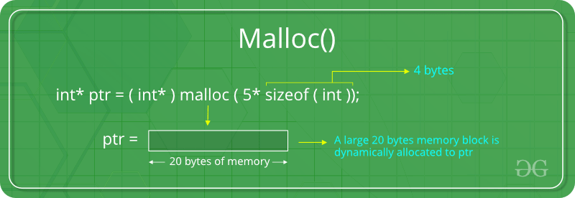
Dynamic Memory Allocation
malloc()

Slide 8
Dynamic Memory Allocation
calloc()
“calloc” or “contiguous allocation” method in C is used to dynamically allocate the specified number of blocks of memory of the specified type. It initializes each block with a default value ‘0’.
ptr = (cast-type*)calloc(n, element-size);
Example:
ptr = (float*) calloc(25, sizeof(float));
This statement allocates contiguous space in memory for 25 elements each with the size of the float
If space is insufficient, allocation fails and returns a NULL pointer.

Slide 9
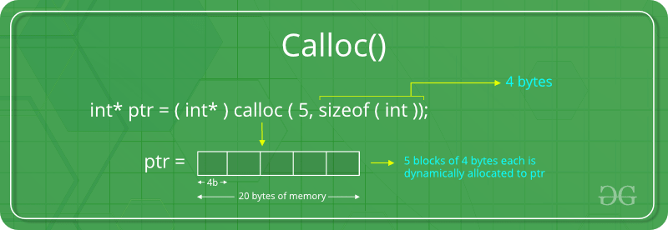
Dynamic Memory Allocation
calloc()

Slide 10
Dynamic Memory Allocation
realloc()
The function realloc use to change the size of the memory block and it alter the size of the memory block without loosing the old data, it is called reallocation of memory.
ptr = realloc(ptr, x);

Slide 11
Dynamic Memory Allocation
free()
“free” method in C is used to dynamically de-allocate the memory.
Memory allocated using functions malloc() and calloc() is not de-allocated on their own.
free helps to reduce wastage of memory by freeing it , whenever the dynamic memory allocation takes place.
free(ptr);

Slide 12
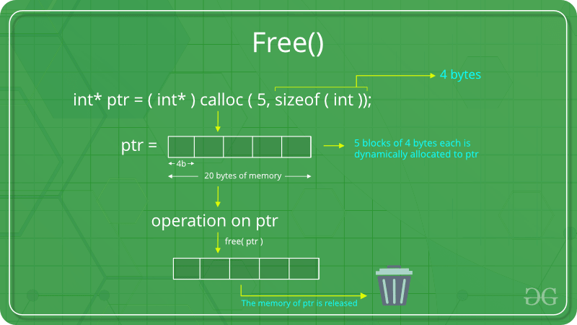
Dynamic Memory Allocation
free()

Slide 13
Dynamic Memory Allocation
Dynamic memory
Advantages:
Data structures can grow Dynamic Allocation is done at run time.
Shrink to fit changing data requirements.
We can allocate (create) additional storage whenever we need them.
We can de-allocate (free/delete) dynamic space whenever we are done with them.
We can always have exactly the amount of space required - no more, no less.
Disadvantages:
As the memory is allocated during runtime, it requires more time.
Memory needs to be freed by the user when done. This is important as it is more likely to turn into bugs that are difficult to find.

Slide 14
Dynamic Memory Allocation
Thank You

